Slide 1

HUM111 Pakistan Studies
Lecture 10

Slide 2
HUM 111 Pakistan Studies
Lecture 10
Topography of Pakistan
Land and People of Pakistan
Dr. Sohail Ahmad

Slide 3

Mountains [3/6]
The Karakoram Range covers the borders between Pakistan, India and China, in the regions of Gilgit-Baltistan (Pakistan), Ladakh (India), and Xinjiang region, (China). The range is about 500 km (311 mile) in length.
The Western Himalayan Range is situated in Kashmir valley. Dominated by Nanga Parbat, Pakistan’s 2nd and world’s 9th highest, is considered as one of the most difficult and dangerous to climb, nick named as Killer Mountain. In local language its called “deo mir”. It is situated in Gilgit-Baltistan.

Slide 4
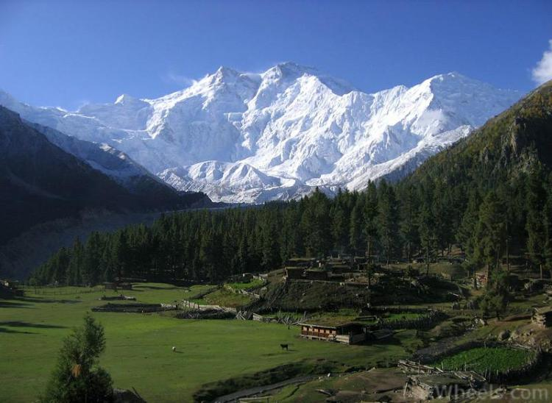
Fairy Meadows

Slide 5
Mountains [4/6]
The Hindu Kush is an 800 km long mountain range that stretches between central Afghanistan and northern Pakistan.
The highest point in the Hindu Kush is Tirich Mir (7,708 m or 25,289 ft.) in Chitral district of Khyber Pakhtunkhwa.
The mountain range separates Central Asia from South Asia.
Numerous high passes (“kotal”) transect the mountains, forming a strategically important network for the transit of caravans.
The most important mountain pass is the Salang Pass.

Slide 6
Mountains [5/6]
Tangi Gharu and Khyber pass
Chitral is considered to be the pinnacle of the Hindu Kush region.
High peaks, as well as countless passes and massive glaciers, are located in this region.

Slide 7
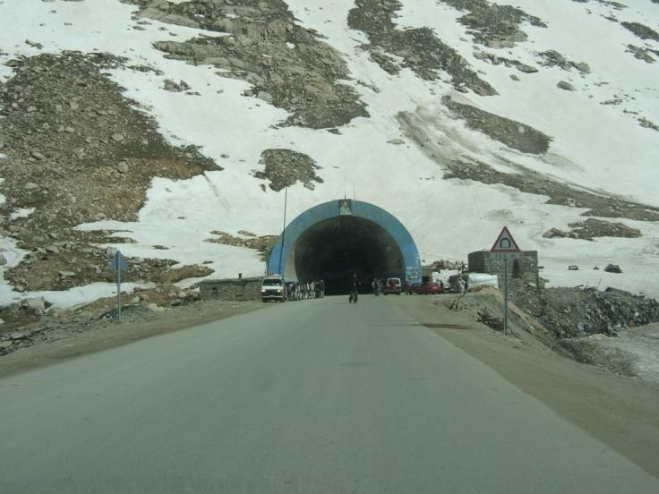
Salang Tunnel Afghanistan

Slide 8
Mountains [6/6]
Pakistan's forth major mountain range is the Suleiman range.
It emerges in the south western region of the country, mostly covering Baluchistan Province.
However, the mountain range is quite different in character from the northern mountains as it is less precipitous, extremely steep, and with medium elevations.
The highest peak is Takht-i-Suleiman rising 3,487 meters above sea level.

Slide 9
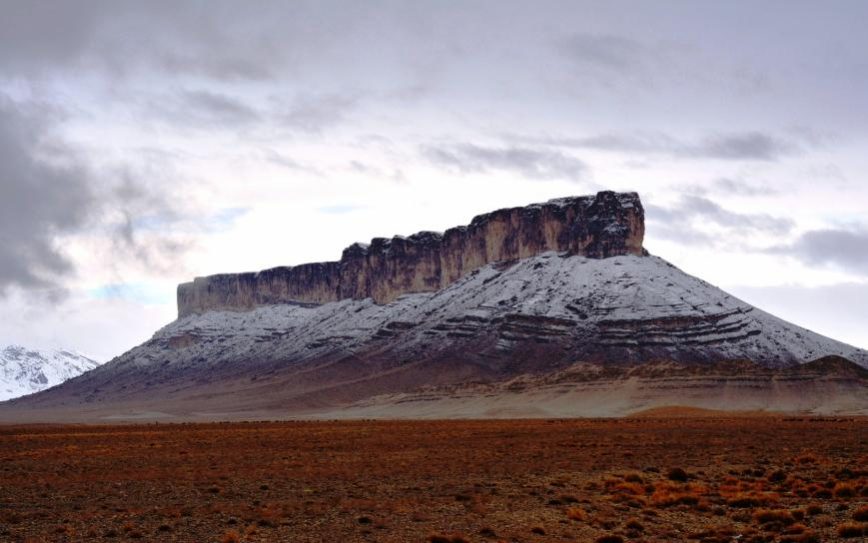
Snow Covered Mesa in Sulaiman Range

Slide 10
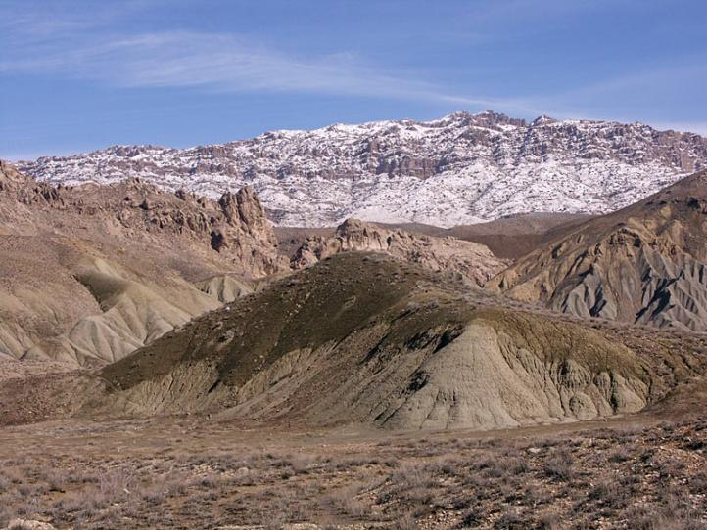
Sulaiman Range

Slide 11
Desert [1/6]
Thal Desert
The Thar Desert (Sindh)
The Cholistan Desert (Punjab)
The Kharan Desert (Baluchistan)

Slide 12
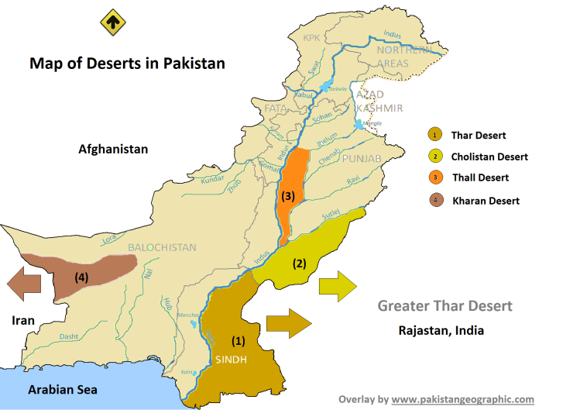
Desert [2/6]

Slide 13
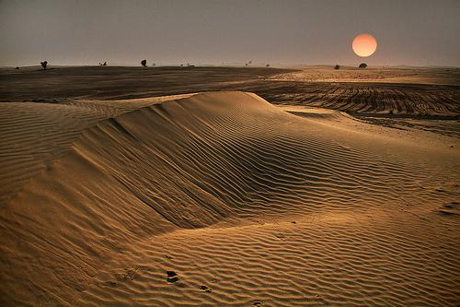
Thal Dessert

Slide 14
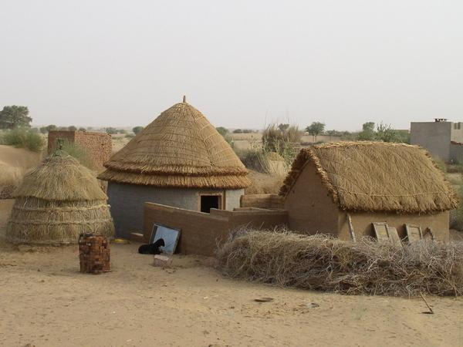
Thar Dessert, Sindh

Slide 15
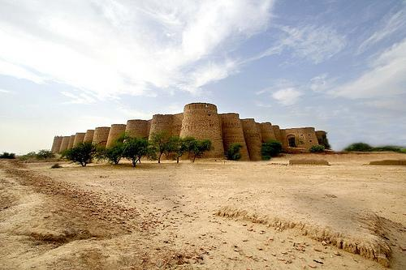
Derawar Fort, Cholistan Desert, Punjab

Slide 16
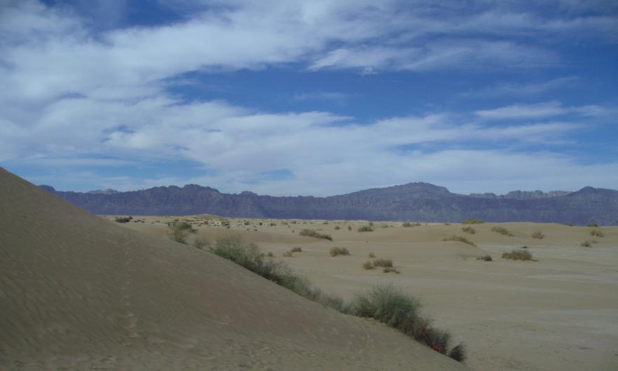
Kharaan Desert, Baluchistan

Slide 17
Desert [3/6]
Thal desert is situated in Punjab, Pakistan.
It is vast area mainly between the Jhelum and Sindh rivers.
Its total length from north to south is 190 miles, and its maximum breadth is 70 miles (110 km) while minimum breadth is 20 miles.
This region is divided into the districts of Bhakkar, Khushab, Mianwali, Jhang, Layyah, and Muzaffargarh.

Slide 18
Desert [4/6]
Thar Desert is the largest among all and mostly falls under the territory of Sind province, extending eastwards from irrigated plains on the left bank of River Indus towards the Indian states of Rajhistan and Gujrat, constituting the largest desert in South Asia, also known as the Great Indian Desert.
The approximate area of greater Thar Desert in total is around 200,000 square KM, of which around 50,000 square KM falls in the Pakistani territories, covering the districts of Tharparker, Mirpur Khas, Umerkot, Khairpur, Sukkar and Ghotki in Sindh Province.

Slide 19
Desert [5/6]
The Cholistan Desert, locally known as Rohi, constitutes the south eastern region of Punjab Province with an estimated area of 26,000 square KM, covering the districts of Bahawalpur, Rahimyar Khan and Bahawalnagar.
Towards the eastern flanks, Cholistan extends into the Indian states of Rajhistan and Punjab, and joins the greater Thar Desert. While on the north-western front it is bordered by the irrigated plains of Indus and Sutlaj rivers. The total estimated population living in these desert districts is around 7.5 million (1998 Census).

Slide 20
Desert [6/6]
The Kharan Desert is situated in the western regions of Baluchistan Province of Pakistan. Overall, all of Baluchistan plateau is characterized by extreme arid conditions and very barren terrain.
However, Kharan desert can be separated from the rest of the arid landscape due to its sandy nature and more even terrain. It mostly falls in the Kharan District covering an estimated area of more than 20,000 Square KM with a population of only 0.23 Million.

Slide 21
Sea
The coastal areas of Pakistan are in the province of Sindh and Baluchistan.
Longest Coastline Of Pakistan is Baluchistan coastline which is 771 KM.
250 KM coast line is in Sindh.
These coastal areas are on the shore of Arabian sea and it connects Pakistan with other countries of the world through a sea route.
Gawadar and Karachi are two prominent ports on these coastal areas of Pakistan.

Slide 22
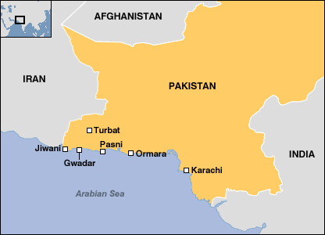
Coastal Areas of Pakistan

Slide 23
Plain
The plain region of Pakistan is largely covered by Punjab and Sindh, where Punjab is highly fertile and suitable for agriculture.

Slide 24
Rivers [1/7]
Chanab River
Indus River
Jhelum River
Ravi River
Kabul River
Sutlej River

Slide 25
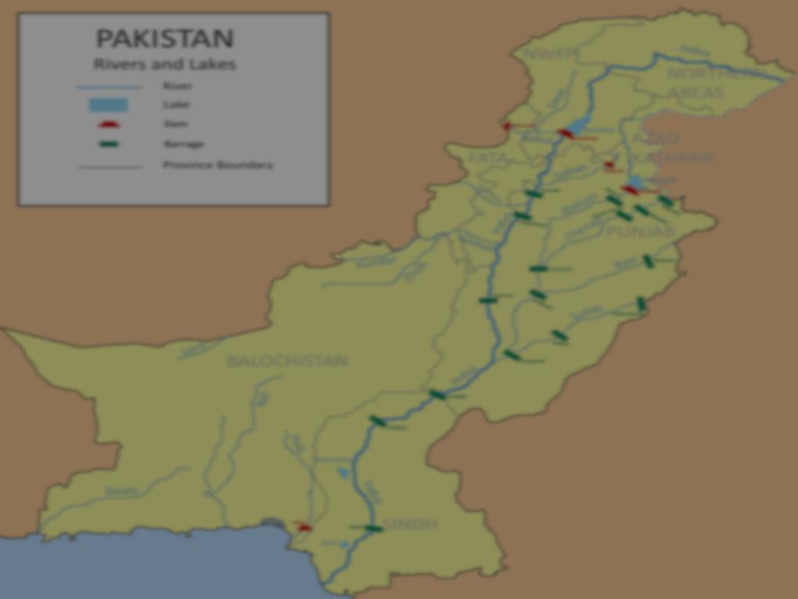
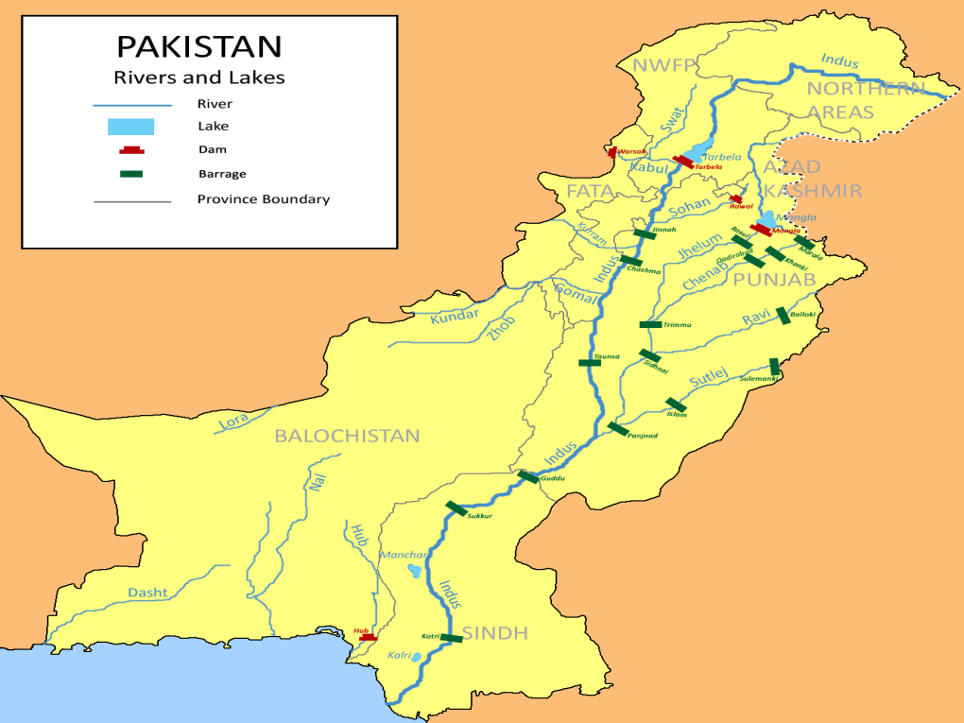
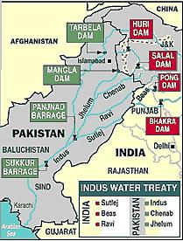

Slide 26
Rivers [2/7]
The Chenab River, is one of the major rivers of Pakistan.
It originates in the Himachal Pradesh-India, and flows through the Jammu region of Jammu and Kashmir into the plains of the Punjab, Pakistan.
Indus river is one of the longest rivers in the world. Originates from the glacial Tibetan mountains, the Indus gushes into Pakistan with all its might and fright from the northern areas. It then runs through Jammu and Kashmir, enters the Gilgit-Baltistan (formerly Northern Areas of Pakistan) region and flows through the entire length of the country and merges with the Arabian Sea.

Slide 27
Rivers [3/7]
Besides Indus, four other rivers also enter Pakistan from the neighboring India, namely the Jhelum, Chenab, Ravi and Sutlej and all empty into the Indus to add to its might and power. The place where all these four rivers meet the Indus is known as Panj Nadh.
In KP its called Abaseen; Aba means father and seen means river. Thus, Abaseen means the father of rivers.
Indus basin water treaty (1960).
Indus basin project (Construction of Mangla Dam-1967- on river Jehlum and Terbela Dam-1976 on river Indus).

Slide 28
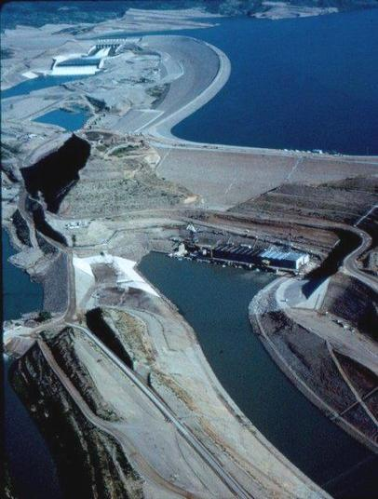
Mangla Dam

Slide 29
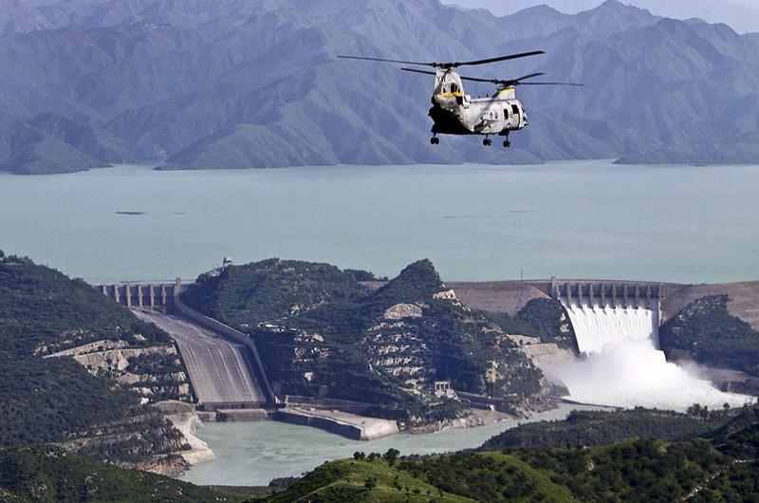
Tarbela Dam

Slide 30
Rivers [4/7]
Kotri Barrage near Hyderabad (1955)
The Taunsa Barrage near Dera Ghazi Khan (1958)

Slide 31
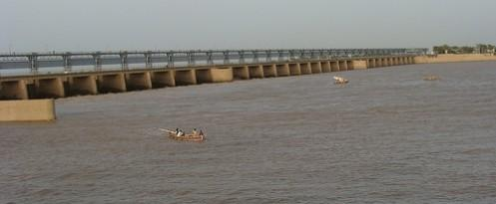
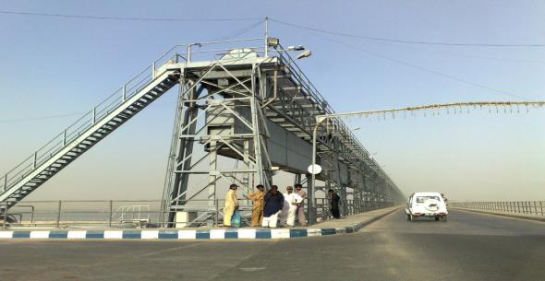
Kotri Barrage

Slide 32
Rivers [5/7]
The Kalabagh dam is a proposed hydroelectric dam planned to be built on the Indus River by the Government of Pakistan.
The proposed site for the dam was situated at Kalabagh in Mianwali District of the Punjab province, bordering the Khyber Pakhtunkhwa.
However, due to reservation of Sindh and KP, construction of the dam could not be started yet.

Slide 33
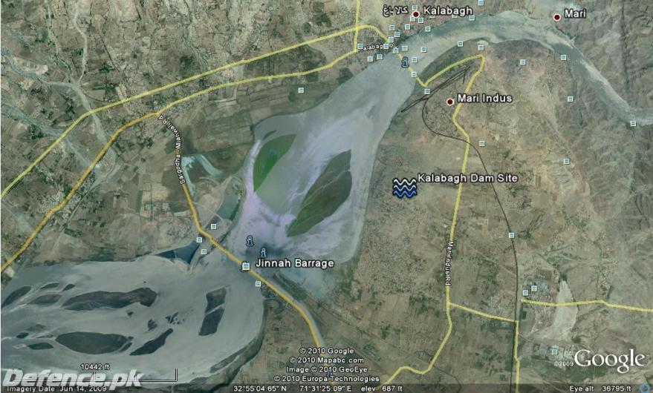
Kalabagh Dam Site

Slide 34
Rivers [6/7]
Jhelum River, originates from India, enters Pakistan Jhelum district.
The Jhelum was crossed in 326 B.C. by Alexander the Great, who defeated the Indian king Porous. The river's ancient name was Hydaspes.
This river is a tributary of the Indus River, and its hydrology is basically handled by snowmelt in the spring and the Indian monsoon.
Strategically very important, any construction of dam by India can effect, Pakistan.

Slide 35
Rivers [7/7]
The Ravi, is a trans-boundary river flowing through Northwestern India and eastern Pakistan. It is one of the six rivers of the Indus System in Punjab region.
Sutlaj, originates from India, enters Punjab, tributary of Indus river.
The hydrology of the Sutlej is controlled by spring and summer snowmelt in the Himalayas and by the South Asian monsoon.

Slide 36
Sources
Most of the text for these slides has been taken from www.forum.urduworld.com , www.Pakistan.wsno.org , www.pakistantoursguide.pk and www.dawn.com

